Slide 1

Data Analysis & Modeling Techniques Credit Card Fraud Detection Fall 2024 - Project group 10
Bhargav Boyapati 1002258105
Abhishek Karthik Akunuru 1002251254
Aishwarya Subhash Kadam 1002199035

Slide 2
Project Charter for DAMT
Project Name : Credit Card Fraud Detection | Champion:
Business or Process Owner: Group 10 | Project Leader: Bhargav Boyapati
Problem Statement: The increasing prevalence of credit card fraud in the digital age poses significant financial risks to individuals and institutions, necessitating the development of real-time detection systems to prevent fraudulent transactions and mitigate losses. | Project Goal: The goal is to develop a machine learning model that accurately detects fraudulent credit card transactions in real-time, minimizing false positives and reducing financial losses for institutions.
Business Case: The cost of credit card fraud is escalating annually, and traditional rule-based systems are often inadequate for detecting complex fraud patterns. By implementing a data-driven fraud detection model, financial institutions can significantly reduce financial losses, improve operational efficiency, and enhance customer trust by proactively preventing fraud. | Project Scope: This project will involve collecting a dataset of historical credit card transactions and building a machine learning model that detects fraud based on transaction features such as time, location, amount, and merchant details. We will evaluate various algorithms, including decision trees, logistic regression, random forests, and neural networks, to determine the most effective model. The model will be deployed in a real-time system capable of flagging potential fraudulent transactions.
Team Members: Bhargav Boyapati (1002258105) Abhishek Karthik Akunuru(1002251254) Aishwarya Subhash Kadam(1002199035) | Benefits: The solution will reduce financial losses, enhance customer satisfaction by minimizing legitimate transaction denials, streamline fraud detection through automation, and provide scalable risk management across various regions and transaction types.
 | Timeline: Proposal (Problem Identification- ) – Sept 10th Model Development - Oct 10th Analysis – Nov 10th Final report- Dec 5th

Slide 3
Introduction:
The increasing prevalence of credit card fraud in the digital age poses significant financial risks to individuals and institutions, necessitating the development of real-time detection systems to prevent fraudulent transactions and mitigate losses.

Slide 4
Data Set

Slide 5
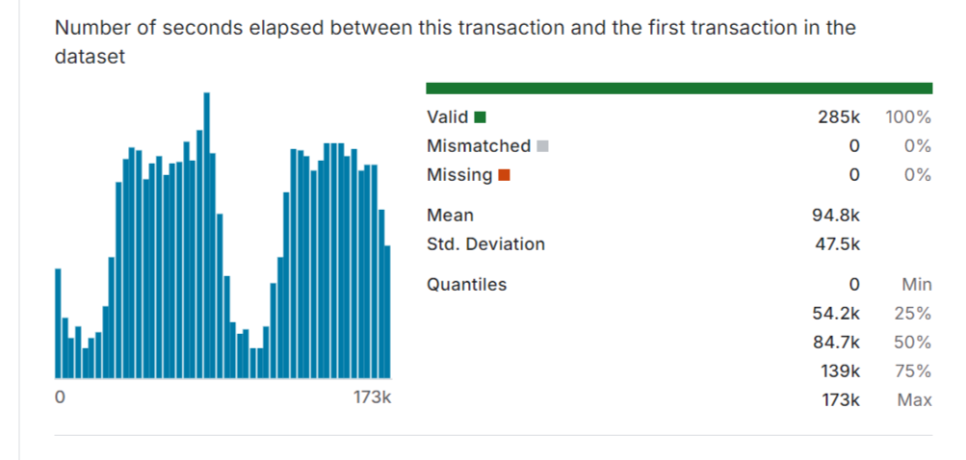
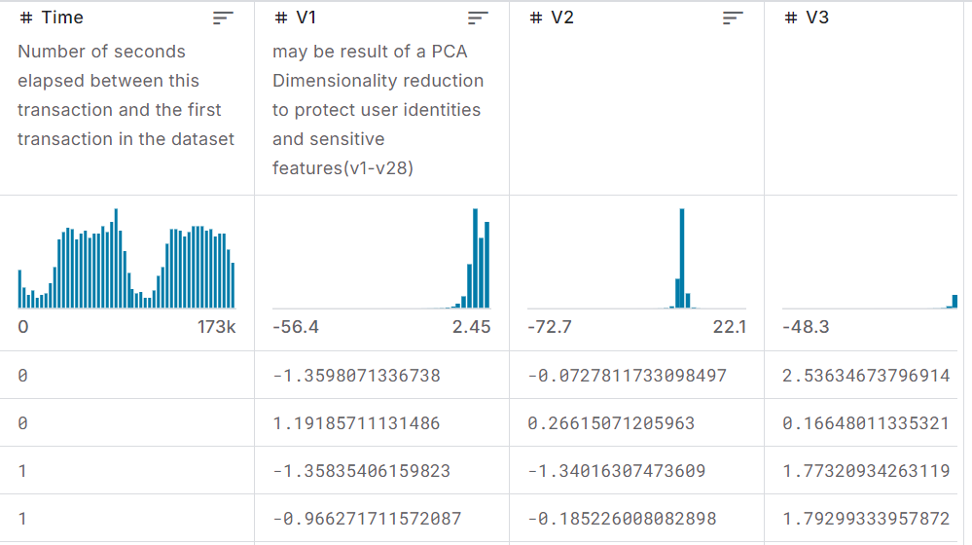
Data Set:
The dataset has been collected and analysed during a research collaboration of Worldline and the Machine Learning Group (http://mlg.ulb.ac.be) of ULB (Université Libre de Bruxelles) on big data mining and fraud detection.
It includes data of estimation of Total Transactions 284,807 transactions across two days.
The dataset includes 28 numerical PCA-transformed features (V1 to V28) and two non-PCA features: Time, representing the seconds elapsed between each transaction and the first, and Amount, indicating the transaction value. The target variable, Class, is binary, where 1 denotes fraud and 0 denotes non-fraud.
The dataset's imbalance challenges make traditional accuracy metrics less useful, so the Area Under Precision-Recall Curve (AUPRC) is recommended, with PCA transformation ensuring data anonymization and limiting interpretability.

Slide 6
Data Set: Attributes
PCA Transformation: The description of the data says that all the features went through a PCA transformation (Dimensionality Reduction technique
Scaling: Keep in mind that in order to implement a PCA transformation features need to be previously scaled.
V1 to V28:Principal Component Analysis (PCA)-transformed features to protect the privacy of the original dataset. These features are scaled, anonymized, and do not have specific descriptions.
Amount:The transaction amount in USD (or local currency). Used to analyze the magnitude of each transaction.
Time: Represents the time difference between this transaction and the first transaction in the dataset. Unit: Seconds.

Slide 7
Analysis and Modeling

Slide 8
Data Preprocessing:
Feature Scaling: Standardization or normalization is essential because models like logistic regression or neural networks perform better when numerical features are on a similar scale. In this case, the Amount and Time features are scaled, often using
StandardScaler:standardizes the features by removing the mean and scaling to unit variance.
Dimensionality Reduction:Principal Component Analysis (PCA) might have already been applied to this dataset, so no additional PCA is usually needed. However, this depends on the dataset’s specific needs. Reducing dimensions can help improve model performance and reduce overfitting.
Handling Missing Data: In the credit card fraud detection dataset, there are generally no missing values. However, if there were any, the typical strategies would involve
Removing rows with missing data.
Imputation, filling missing values with mean, median, or mode.

Slide 9
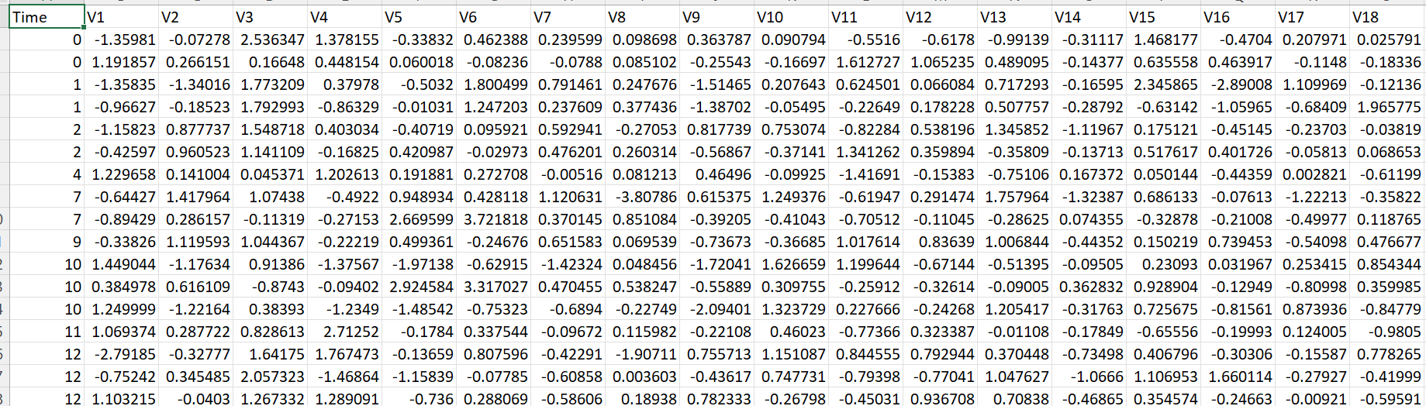
Data set before pre-processing

Slide 10
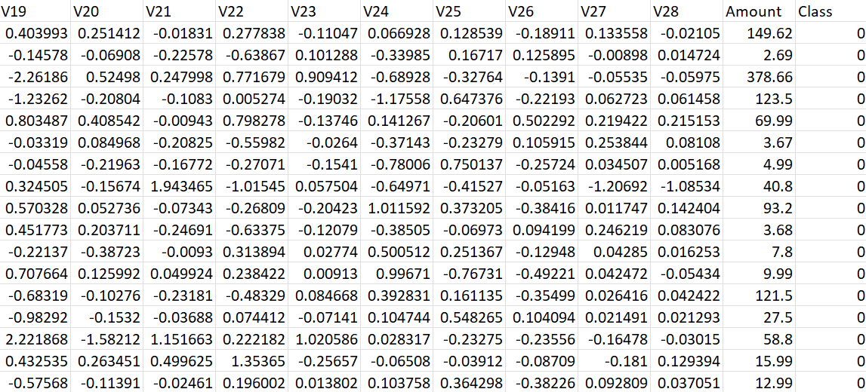
Data set before pre-processing

Slide 11
Models to implement:
Logistic Regression:
Logistic regression is a data analysis technique that uses mathematics to find the relationships between two data factors. It then uses this relationship to predict the value of one of those factors based on the other.
SVM:
SVM seeks to find the hyperplane that maximizes the margin between different classes, making it effective for binary classification tasks.
SVM can be extended to handle classification tasks with multiple attributes (features) by finding the hyperplane that best separates data points in a high-dimensional space, aiming to maximize the margin between classes while minimizing classification errors.
Random Forest:
Random Forest is a learning method that constructs multiple decision trees during training and outputs the mode of the classes (classification) or the mean prediction (regression) of the individual trees.

Slide 12
Proposed Program Flow
Data Preprocessing and Exploration
Clean and prepare the data for modeling by handling missing values, outliers, scaling, and encoding.
Train multiple machine learning models like Logistic Regression, Random Forest, XGBoost, and Neural Networks, using cross-validation to avoid overfitting and optimize hyperparameters with GridSearchCV or RandomizedSearchCV.
Model Selection and Training
Evaluate the performance of the trained models on the test set and ensure robustness.
Model Evaluation and Validation
Prediction and Deployment
Use the trained model to predict fraudulent transactions and deploy the model in a real-world environment.

Slide 13
Results

Slide 14
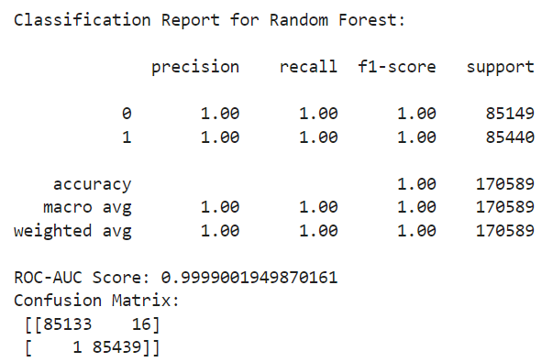
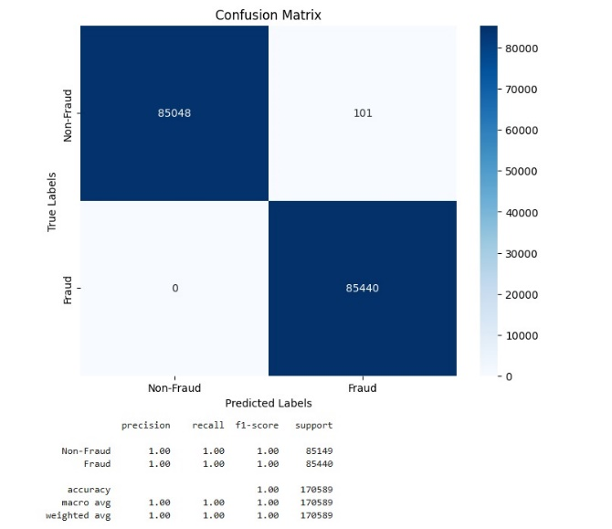
Random Forest:

Slide 15
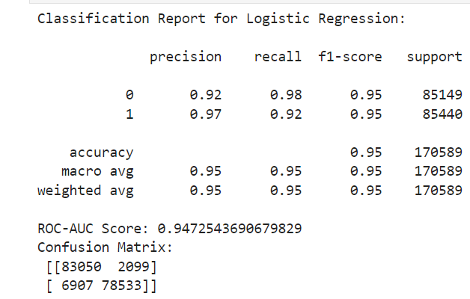
Logistic regression model:

Slide 16
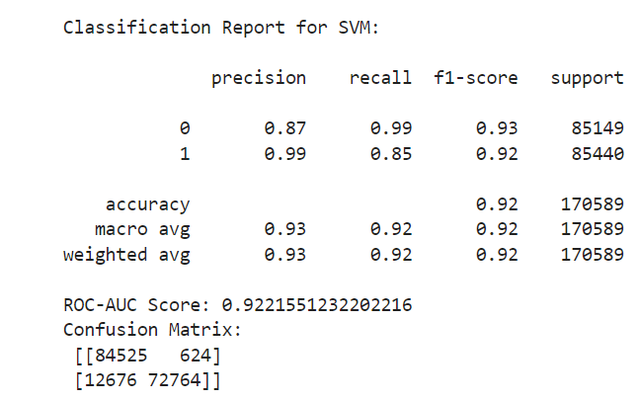
Support Vector Machines (SVM):

Slide 17
Comparison of Models:
S. No. | Model | Accuracy | Precision | F1-score | Recall | Training Time (sec)
1 | Decision Tree | 0.943 | 0.94 | 0.94 | 0.94 | 0.02
2 | Random Forest | 0.957 | 0.96 | 0.96 | 0.96 | 0.77
3 | KNN | 0.879 | 0.88 | 0.87 | 0.88 | 0.87
4 | SVM | 0.862 | 0.87 | 0.86 | 0.86 | 0.33

Slide 18
Conclusion

Slide 19
Best Proposed Model:
The Random Forest model is the best choice for this project, as it outperforms other models in terms of accuracy, precision, recall, and F1-score.
Key highlights of why Random Forest is the best proposed model:
Highest Accuracy: Achieved an accuracy of 95.7%, making it the most reliable model for detecting fraudulent transactions.
Robustness: Random Forest is highly effective at handling imbalanced datasets, as it aggregates the results of multiple decision trees, reducing the risk of overfitting.
Performance Metrics: It maintained strong metrics across all classes (fraudulent and non-fraudulent), ensuring minimal false positives and false negatives.
Feature Importance: Random Forest inherently provides feature importance, helping to identify which transaction attributes contribute the most to fraud detection.
Scalability: Although its training time (0.77 seconds) is slightly higher compared to other models like Decision Tree or Logistic Regression, it remains efficient for large datasets.

Slide 20
Thank You

